Slide 1



Slide 2
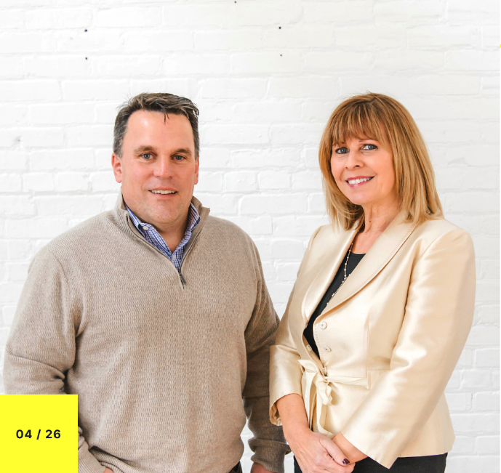


OUR CLIENT FIRST PHILOSOPHY
There are many qualities and skills that go into being an excellent real estate professional: integrity, in-depth community and market knowledge, marketing savvy, effective negotiation skills, and a high-quality professional network… all of which are hallmarks of how we run our business.
CHRIS PARDEE, BROKER / OWNER
“At Premier Real Estate Agency, we employ dozens of agents, helping to improve our local economy and also touching the lives of hundreds of clients. The wide range of tools provided by Premier Real Estate Agency helps our agents manage every aspect of the buying and selling process and has brought a new level of service to real estate in the area.”
MARCY BENSON, REALTOR / OWNER
“Together, we pioneered new and innovative marketing that exceeded the expectations of our clients. We have had experience in nearly every kind of real estate transaction, from simple residential purchases, to complex commercial transactions.”

Slide 3
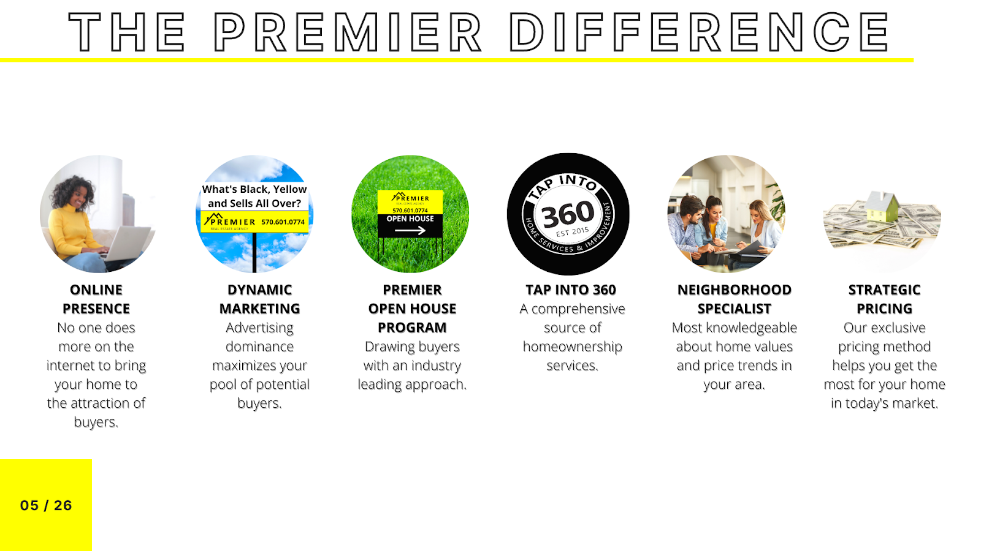

Slide 4
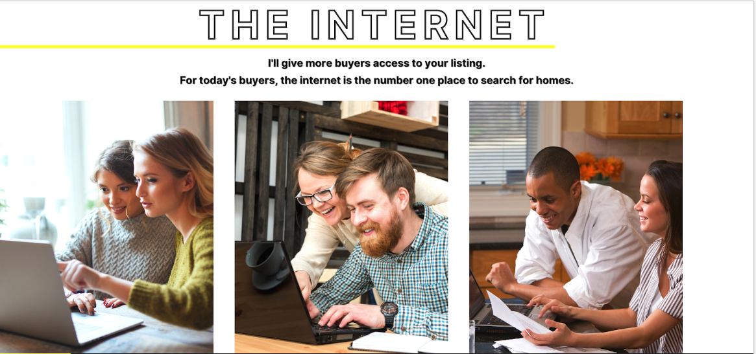
More than 40 times as many buyers find the home they purchase online than in newspapers.
3 of every 4 online shoppers see at least 1 home in person.
Now that the majority of buyers search the internet, newspapers are no longer the favorite source for listings.

Slide 5
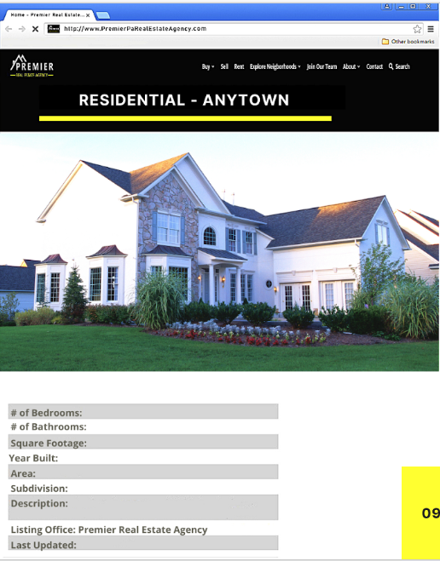
The property description will go into full detail of your home, as well as highlighting its best features to attract the most buyers.

Slide 6

88% of all buyers find yard signs useful when searching for a home.
Customized flyers will be created and distributed to high traffic areas and on social media.

Slide 7

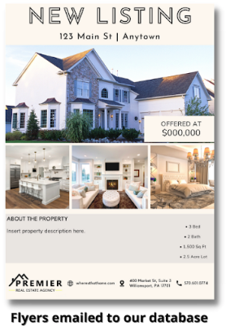

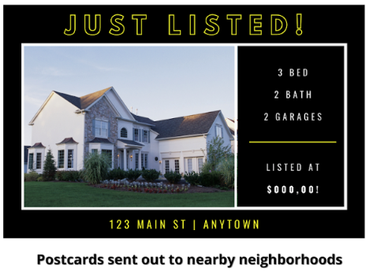
We customize our marketing to alert local buyers directly.
88% of all buyers find yard signs useful when searching for a home.
Customized flyers will be created and distributed to high traffic areas and on social media.

Slide 8
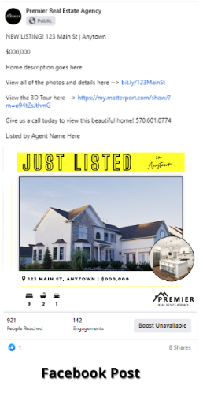
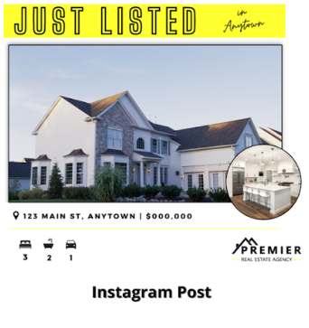
We customize our marketing to alert local buyers directly.
88% of all buyers find yard signs useful when searching for a home.
Customized flyers will be created and distributed to high traffic areas and on social media.

Slide 9
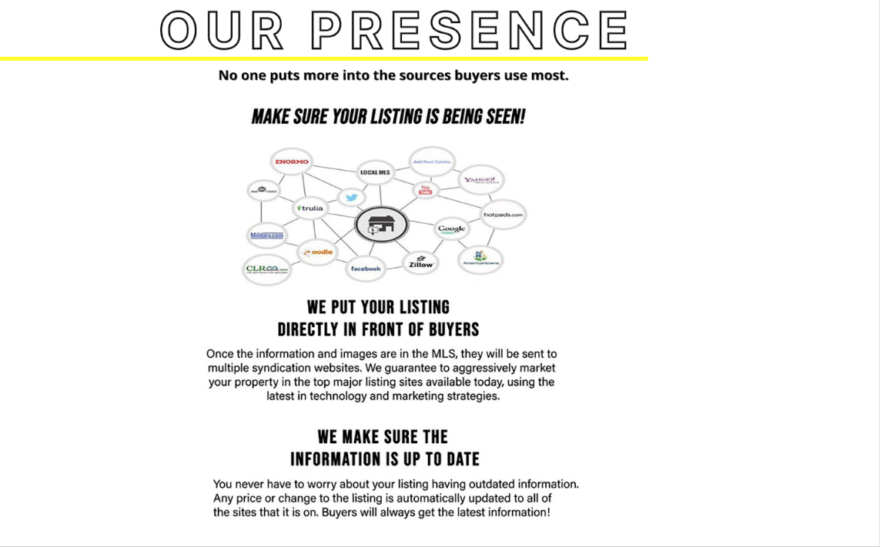
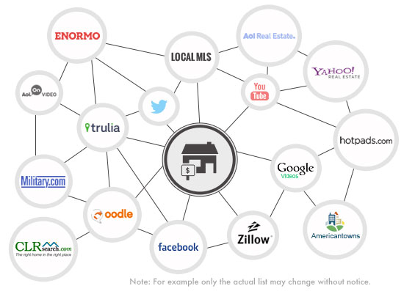
Realtor.com

Slide 10

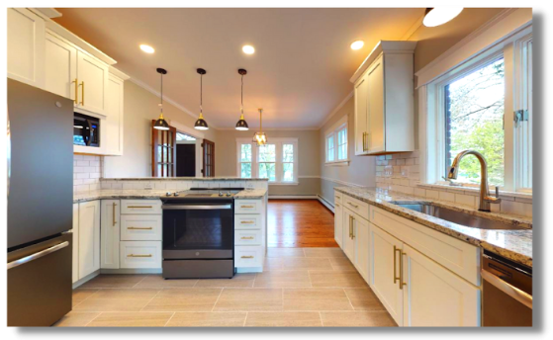
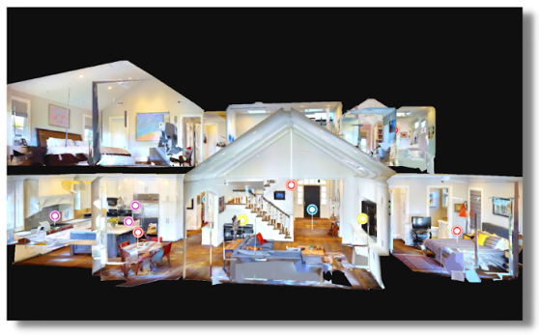
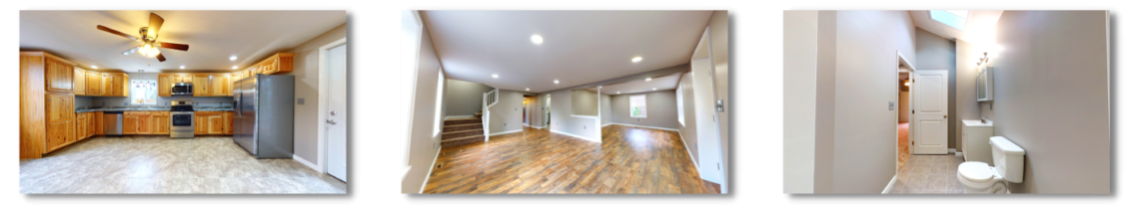
Matterport: The Ultimate, Always-On Open House
3D tours are an online experience for homebuyers that allows them to see the property from every angle. Our distinct dollhouse view gives homebuyers a completely unique sense of the property. It’s obvious the videos help. However, a simple video just won’t cut it anymore - nor will great photos. Today, for realtors to set themselves apart in the digital marketing age, they need 3D models to showcase your homes. This camera captures a 3D dollhouse rendering of any space that can be toured and viewed across any device.

Slide 11


We attract countless home buyers to our open houses.
Almost 3 out of every 4 homebuyers visit at least 1 open house.
92% of buyers found open houses to be a useful source of information while looking for a home.
According to a NAR 2019 study, homes sell for $9,000 more on average, and they spend about a week less on the market.

Slide 12

Our open houses lead more directly to your success.

Slide 13


By working with our Tap Into 360 partners to provide the services your potential buyers need, we’re able to help ensure a smooth closing for you.

Slide 14
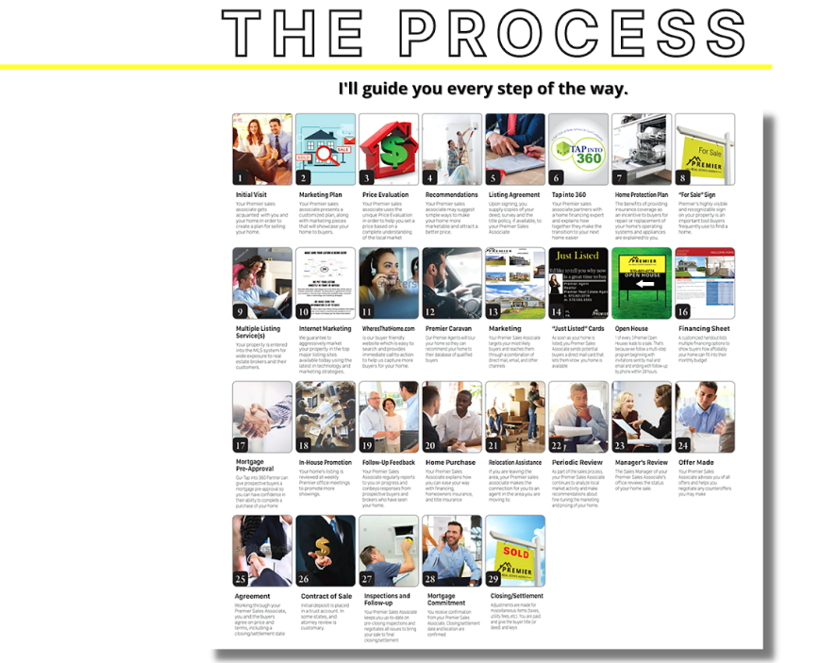

Slide 15
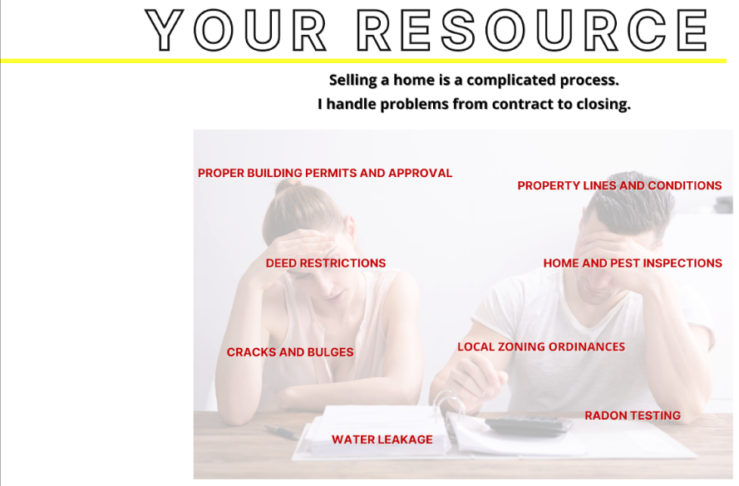
A surprising amount of my efforts and expertise come into play between your signed offer and your closing.

Slide 16
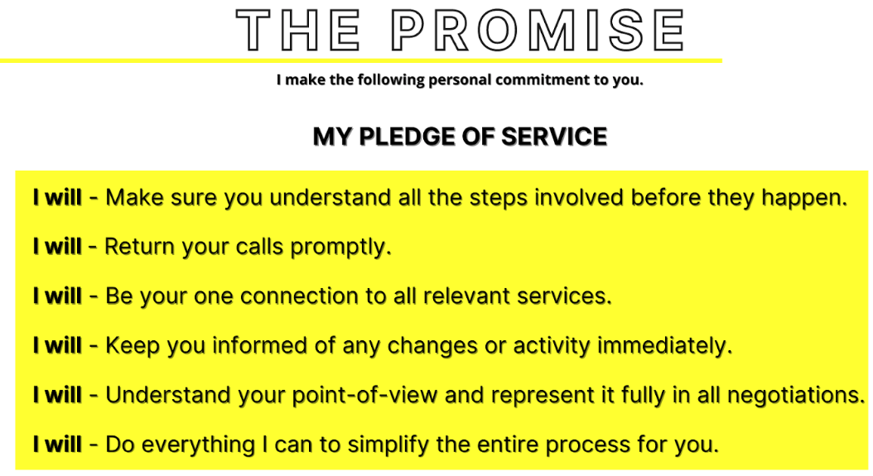
You and I have one goal: To get you the best price and terms for your home as quickly and smoothly as possible.

